Slide 1
AI Powered Smart Waste Management System
Revolutionizing Urban Cleanliness using IoT, ML & Smart Routing
“Not just a project — a city-scale solution.”

Slide 2
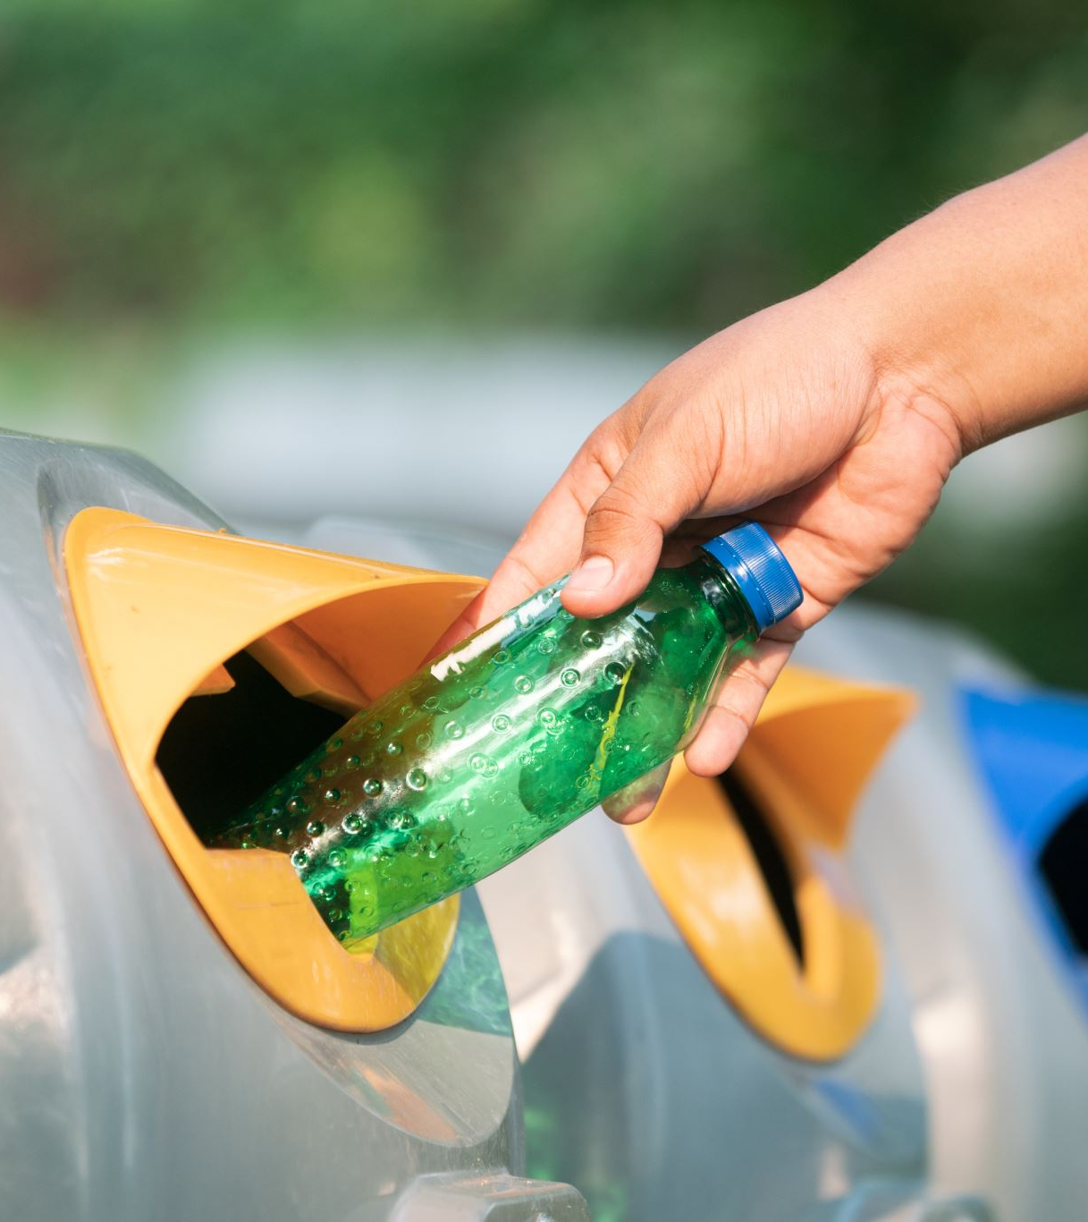
The Problem We Are Solving
Every day cities suffer from:
Overflowing garbage bins
Toxic methane gas & bad smell
Disease spreading waste
Inefficient collection routes
Huge manpower & fuel loss
Cities are growing… but waste systems are not.

Slide 3

We envision a future where:
Bins think
Data decides
AI plans
Cities breathe clean
This project builds the foundation of a Smart City Waste Brain.
Our Vision
From Manual Cleaning → Intelligent City Infrastructure

Slide 4

Our Innovation
What Makes Our System Different?
✔ Real-time IoT sensing ✔ AI-driven waste intelligence ✔ Predictive risk analysis ✔ Automatic priority classification ✔ Smart route optimization ✔ Fully live monitoring dashboard
This is not monitoring… this is decision automation.

Slide 5

Hardware That Feeds Intelligence
IoT Powered Smart Bin
We built a smart dustbin using:
ESP32 – IoT Brain
Ultrasonic Sensor – Fill Level
Soil Moisture Sensor – Wet / Dry Detection
MQ4 Sensor – Methane Gas
DHT11 – Temperature
Neo-6M GPS – Live Location
The bin becomes a living data source.

Slide 6

Data Pipeline
Sensors → ESP32 → ThingSpeak Cloud → API → ML Engine → Smart Dashboard
Real-time data is streamed through ThingSpeak using API keys directly into our ML models.

Slide 7
Machine Learning Engine
Two Powerful AI Models
🔹 Model 1: K-Means Clustering
Automatically classifies bins into:
Low Priority
Medium Priority
High Priority
🔹 Model 2: Random Forest Regression
Predicts future fill levels & risk trends.
The system doesn’t wait for overflow. It predicts it.

Slide 8
Smart Command Dashboard
Our MERN Stack dashboard provides:
Live bin status
AI risk prediction
Priority heatmaps
Methane danger alerts
Predictive graphs
Live system health
This becomes the control center of a city.

Slide 9
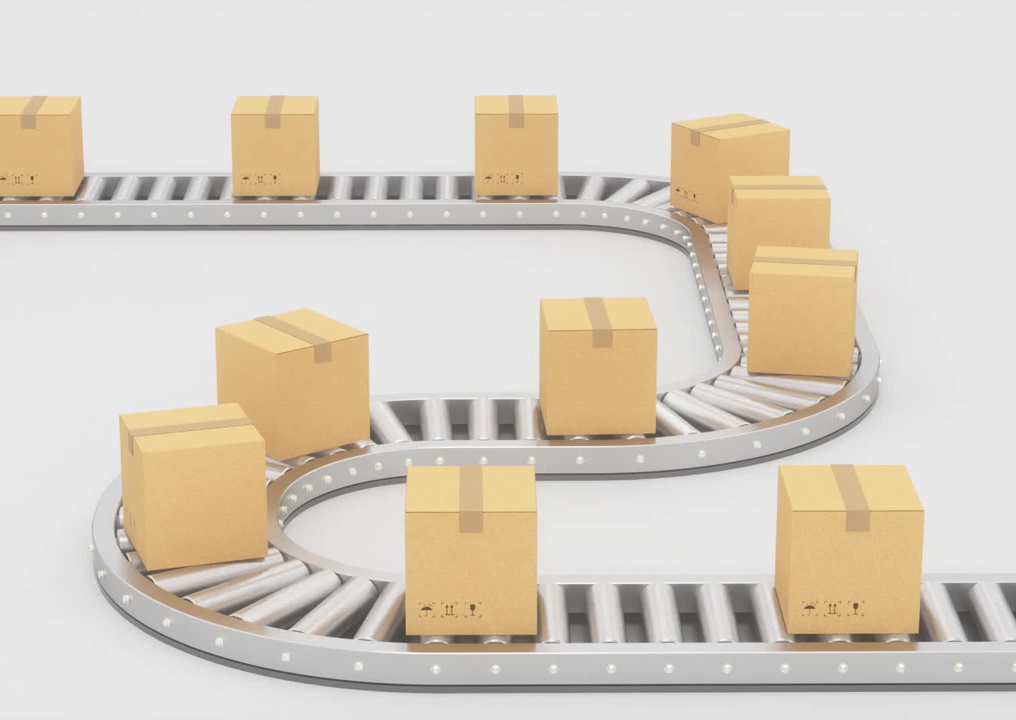
Smart Route Optimization
We compute shortest & safest collection routes in real-time:
Reduces fuel consumption
Saves time
Improves worker safety
Maximizes city efficiency
Garbage trucks no longer guess — they follow intelligence

Slide 10

Impact
Reduces disease & health risks
Cuts operational costs
Improves environmental sustainability
Enables scalable smart cities
Protects workers & citizens

Slide 11

What Makes Us Hackathon-Ready
We already have: ✔ Working IoT prototype ✔ Real-time data ingestion ✔ Trained ML models ✔ Live dashboard ✔ End-to-end automation
This is not a concept — this is a deployable system.

Slide 12

Future Expansion
If selected for the hackathon, we will extend this system with:
AI Image-based waste segregation
Computer vision powered classification
Mobile app integration
Large-scale city deployment
Advanced multi-route optimization

